Slide 1
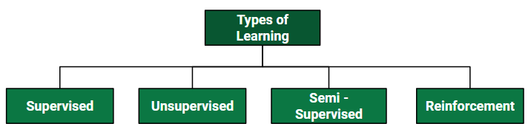
Types of Learning

Slide 2
ML algorithm List
DBSCAN Clustering
Naive Bayes
Gradient Boosting Logistic Regression
Linear Regression
Apriori Algorithm
K Nearest Neighbor
CatBoost
SMOTE
Hypothesis Testing
Tf-Idf Vectorization
Cross-Validation
4 Graph Algorithms Ridge and Lasso Regression
Notes:
https://www.datacamp.com/tutorial/decision-tree-classification-python

Slide 3
ML algorithm List
StandardScaler
SARIMA
ARIMA
XGBoost Algorithm
Long Short Term Memory (LSTM)
One Hot Encoding
Bidirectional Encoder Representations from Transformers (BERT)
Facebook Prophet
NeuralProphet
AdaBoost Algorithm
Random Forest Algorithm
H2O AutoML
Polynomial Regression
Gradient Descent Algorithm
Grid Search Algorithm
K-Means Algorithm

Slide 4
ML Algorithm List
Manifold Learning
Principal Component Analysis
Decision Trees
Support Vector Machines
Neural Networks
FastAI
LightGBM

Slide 5
Different Models of Supervised Learning

Slide 6
Outline
Different Models of Supervised Learning
Linear Regression:
Logistic Regression:
Decision Trees:
Random Forests:
Support Vector Machine(SVM)
K-Nearest Neighbors (KNN)
Gradient Boosting

Slide 7
Decision Tree Overview
Decision Tree is a Supervised learning technique that can be used for both classification and Regression problems, but mostly it is preferred for solving Classification problems.
It is a tree-structured classifier, where internal nodes represent the features of a dataset, branches represent the decision rules and each leaf node represents the outcome.
In a Decision tree, there are two nodes, which are the Decision Node and Leaf Node. Decision nodes are used to make any decision and have multiple branches, whereas Leaf nodes are the output of those decisions and do not contain any further branches.

Slide 8
Overview
The decisions or the test are performed on the basis of features of the given dataset.
It is a graphical representation for getting all the possible solutions to a problem/decision based on given conditions.
It is called a decision tree because, similar to a tree, it starts with the root node, which expands on further branches and constructs a tree-like structure.
In order to build a tree, we use the CART algorithm, which stands for Classification and Regression Tree algorithm.
A decision tree simply asks a question, and based on the answer (Yes/No), it further split the tree into subtrees.

Slide 9
The Decision Tree Algorithm
A decision tree is a flowchart-like tree structure where an internal node represents a feature(or attribute), the branch represents a decision rule, and each leaf node represents the outcome.
The topmost node in a decision tree is known as the root node.
It learns to partition on the basis of the attribute value.
It partitions the tree in a recursive manner called recursive partitioning. This flowchart-like structure helps you in decision-making. It's visualization like a flowchart diagram which easily mimics the human level thinking. That is why decision trees are easy to understand and interpret.

Slide 10

Entropy
Entropy: Entropy is the measure of uncertainty or randomness in a data set. Entropy handles how a decision tree splits the data.
It is calculated using the following formula:

Slide 11
Information Gain
The information gain measures the decrease in entropy after the data set is split.
It is calculated as follows:
IG( Y, X) = Entropy (Y) - Entropy ( Y | X)

Slide 12
Gini Index:
The Gini Index is used to determine the correct variable for splitting nodes. It measures how often a randomly chosen variable would be incorrectly identified.

Slide 13
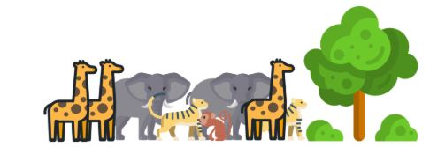
Decision Tree Algorithm Work

Slide 14
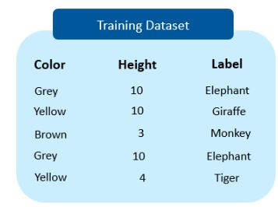

Slide 15
We have to determine which features split the data so that the information gain is the highest. We can do that by splitting the data using each feature and checking the information gain that we obtain from them.
The feature that returns the highest gain will be used for the first split

Slide 16
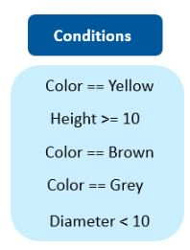
We’ll use the information gain method to determine which variable yields the maximum gain, which can also be used as the root node

Slide 17
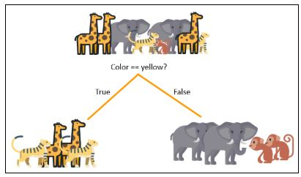
Suppose Color == Yellow results in the maximum information gain, so that is what we will use for our first split at the root node

Slide 18
The entropy after splitting should decrease considerably. However, we still need to split the child nodes at both the branches to attain an entropy value equal to zero.

Slide 19
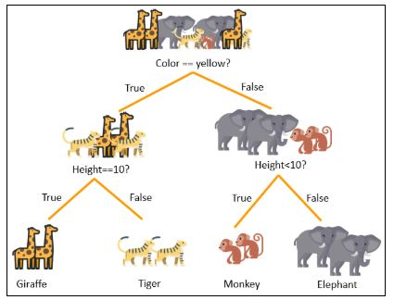
We will split both the nodes using ‘height’ variable and height > 10 and height < 10 as our conditions.

Slide 20
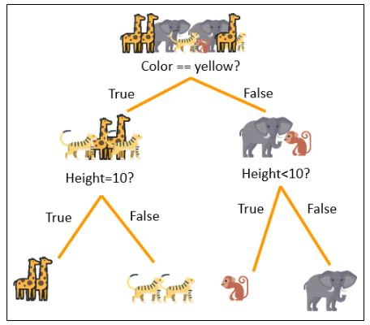
The decision tree above can now predict all the classes of animals present in the data set. Now, it’s time to build a prediction model using the decision tree in Python.

Slide 21
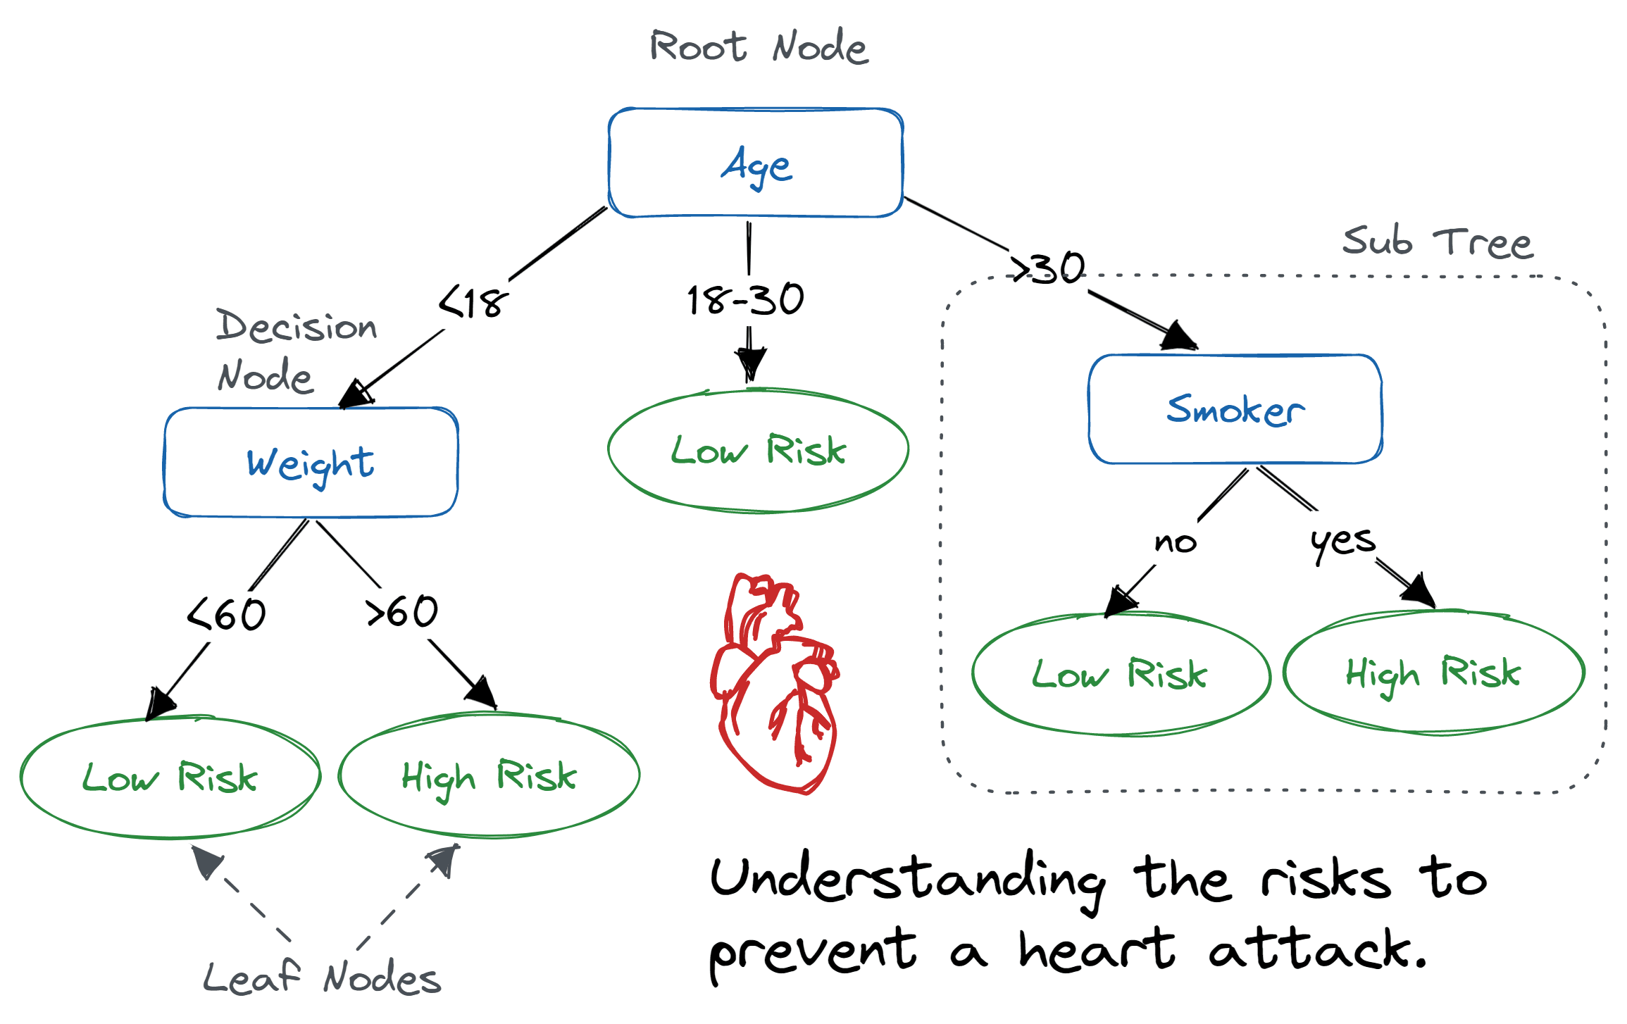

Slide 22
How Does the Decision Tree Algorithm Work?
YouTube video :https://www.youtube.com/watch?v=LDRbO9a6XPU
The basic idea behind any decision tree algorithm is as follows:
Select the best attribute using Attribute Selection Measures (ASM) to split the records.
Make that attribute a decision node and breaks the dataset into smaller subsets.
Start tree building by repeating this process recursively for each child until one of the conditions will match:
All the tuples belong to the same attribute value.
There are no more remaining attributes.
There are no more instances.
https://www.youtube.com/watch?v=LDRbO9a6XPU
Notes:
https://www.datacamp.com/tutorial/decision-tree-classification-python

Slide 23
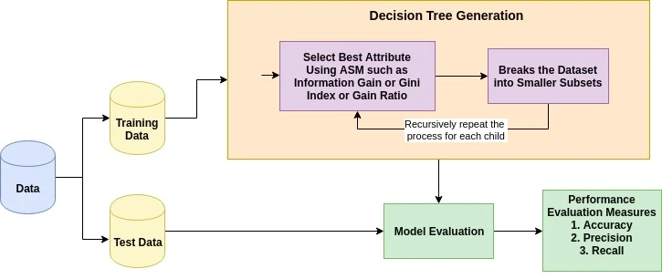

Slide 24
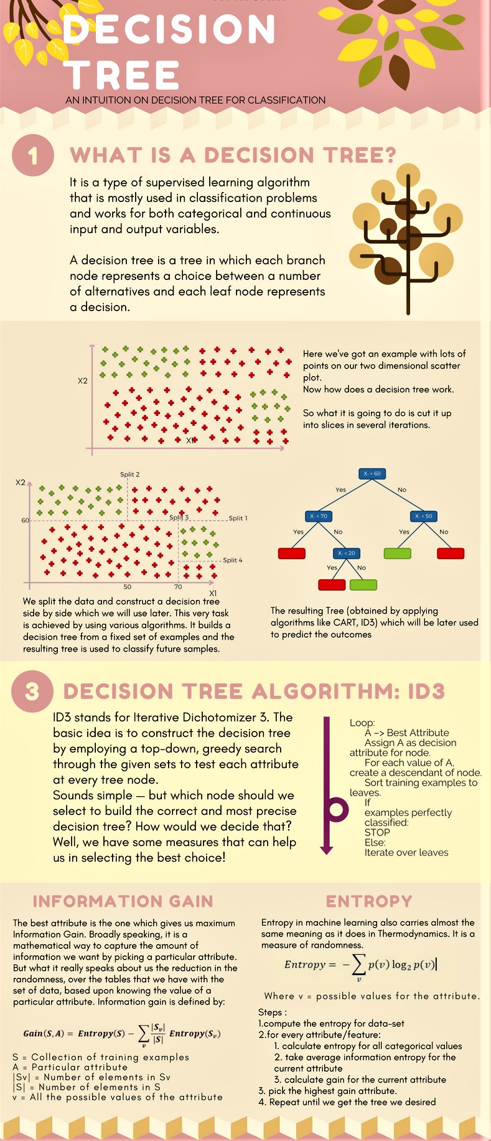

Slide 28
Logistic Regression in Machine Learning
Logistic regression is one of the most popular Machine Learning algorithms, which comes under the Supervised Learning technique. It is used for predicting the categorical dependent variable using a given set of independent variables.
Logistic regression predicts the output of a categorical dependent variable. Therefore the outcome must be a categorical or discrete value. It can be either Yes or No, 0 or 1, true or False, etc. but instead of giving the exact value as 0 and 1, it gives the probabilistic values which lie between 0 and 1.

Slide 29
Logistic Regression is much similar to the Linear Regression except that how they are used. Linear Regression is used for solving Regression problems, whereas Logistic regression is used for solving the classification problems.
In Logistic regression, instead of fitting a regression line, we fit an "S" shaped logistic function, which predicts two maximum values (0 or 1).

Slide 30
What is Linear Regression?
Linear regression is a type of statistical analysis used to predict the relationship between two variables.
It assumes a linear relationship between the independent variable and the dependent variable, and aims to find the best-fitting line that describes the relationship.
The line is determined by minimizing the sum of the squared differences between the predicted values and the actual values.

Slide 31
Linear regression application
Linear regression is commonly used in many fields, including economics, finance, and social sciences, to analyze and predict trends in data.
It can also be extended to multiple linear regression, where there are multiple independent variables, and logistic regression, which is used for binary classification problems.

Slide 32
Simple Linear Regression
In a simple linear regression, there is one independent variable and one dependent variable. The model estimates the slope and intercept of the line of best fit, which represents the relationship between the variables.
The slope represents the change in the dependent variable for each unit change in the independent variable, while the intercept represents the predicted value of the dependent variable when the independent variable is zero.

Slide 33
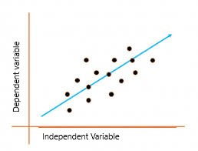
Linear regression is a quiet and the simplest statistical regression method used for predictive analysis in machine learning.
Linear regression shows the linear relationship between the independent(predictor) variable i.e. X-axis and the dependent(output) variable i.e. Y-axis, called linear regression. If there is a single input variable X(independent variable), such linear regression is called simple linear regression.

Slide 34
The graph above presents the linear relationship between the output(y) and predictor(X) variables. The blue line is referred to as the best-fit straight line. Based on the given data points, we attempt to plot a line that fits the points the best.
To calculate best-fit line linear regression uses a traditional slope-intercept form which is given below,
Y_{i} = β₀ + β₁X_{i}
where Y_{i} = Dependent variable, β₀ = constant/Intercept, β₁ = Slope/Intercept, X_{i} = Independent variable.

Slide 35
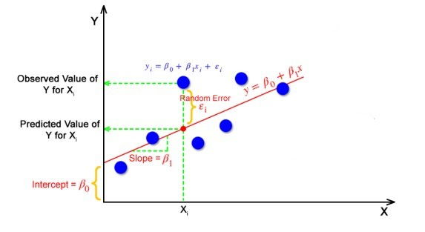
This algorithm explains the linear relationship between the dependent(output) variable y and the independent(predictor) variable X using a straight line Y= B₀ + B₁ X.

Slide 36
But how the linear regression finds out which is the best fit line?
The goal of the linear regression algorithm is to get the best values for B₀ and B₁ to find the best fit line. The best fit line is a line that has the least error which means the error between predicted values and actual values should be minimum.
Random Error(Residuals)
In regression, the difference between the observed value of the dependent variable(y_{i}) and the predicted value(predicted) is called the residuals.
ε_{i} = y_{predicted} – y_{i}
where y_{predicted} = B₀ + B₁ X_{i}
the best fit line is a line that fits the given scatter plot in the best way. Mathematically, the best fit line is obtained by minimizing the Residual Sum of Squares(RSS).
Cost Function
The least Sum of Squares of Errors is used as the cost function for Linear Regression.
For all possible lines, calculate the sum of squares of errors. The line which has the least sum of squares of errors is the best fit line.

Slide 37
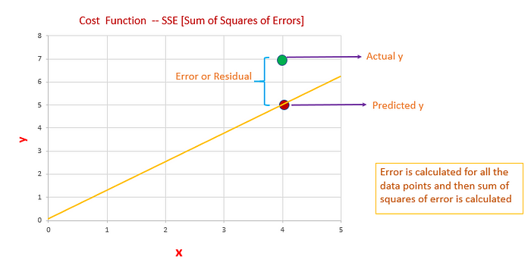

Slide 38
Two independent variable
A regression with two independent variables such as the example discussed above will produce a formula with this basic structure:
y= c + b1(x1) + b2(x2)
In this equation, y is the dependent variable, c is a constant, b1 is the first regression coefficient and x1 is the first independent variable. The second coefficient and second independent variable are b2 and x2, respectively. Drawing from the above example, the stock price would be y, the S&P 500 would be x1 and the unemployment rate would be x2. The coefficient of each independent variable represents the degree of change in y for each additional unit in that variable.
If the S&P 500 increases by one, the resulting y or share price will go up by the amount of the coefficient. The same is true for the second independent variable, the unemployment rate. In a simple regression with one independent variable, that coefficient is the slope of the line of best fit. In this example or any regression with two independent variables, the slope is a mix of the two coefficients. The constant c is the y-intercept of the line of best fit.

Slide 39
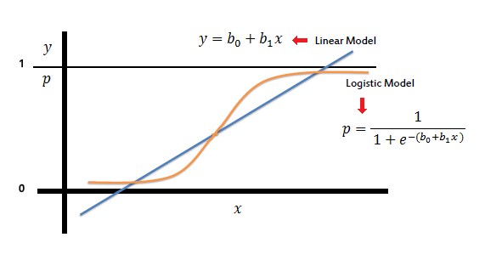
In the logistic regression the constant (b₀) moves the curve left and right and the slope (b₁) defines the steepness
of the curve. By simple transformation, the logistic regression equation can be written in terms of an odds ratio.
a logistic regression produces a logistic curve, which is limited to values between 0 and 1.
Logistic regression is similar to a linear regression, but the curve is constructed using the natural logarithm of the “odds” of the target variable, rather than the probability. Moreover, the predictors do not have to be normally distributed or have equal variance in each group.
Notes:
https://saedsayad.com/logistic_regression.htm

Slide 40
The curve from the logistic function indicates the likelihood of something such as whether the cells are cancerous or not, a mouse is obese or not based on its weight, etc.
Logistic Regression is a significant machine learning algorithm because it has the ability to provide probabilities and classify new data using continuous and discrete datasets.
Some examples of such classifications and instances where the binary response is expected or implied are:
1. Determine the probability of heart attacks: With the help of a logistic model, medical practitioners can determine the relationship between variables such as the weight, exercise, etc., of an individual and use it to predict whether the person will suffer from a heart attack or any other medical complication.
2. Possibility of enrolling into a university: Application aggregators can determine the probability of a student getting accepted to a particular university or a degree course in a college by studying the relationship between the estimator variables, such as GRE, GMAT, or TOEFL scores.
3. Identifying spam emails: Email inboxes are filtered to determine if the email communication is promotional/spam by understanding the predictor variables and applying a logistic regression algorithm to check its authenticity.

Slide 41
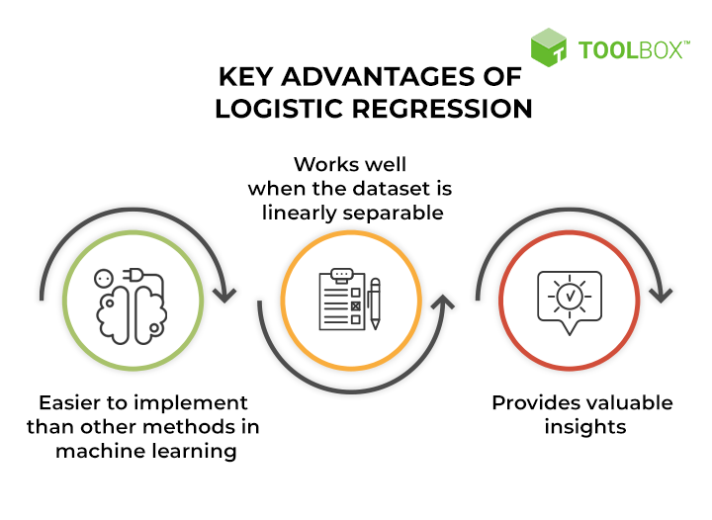
Key advantages of logistic regression

Slide 42
Logistic Regression Equation and Assumptions
Logistic regression uses a logistic function called a sigmoid function to map predictions and their probabilities. The sigmoid function refers to an S-shaped curve that converts any real value to a range between 0 and 1.
Moreover, if the output of the sigmoid function (estimated probability) is greater than a predefined threshold on the graph, the model predicts that the instance belongs to that class. If the estimated probability is less than the predefined threshold, the model predicts that the instance does not belong to the class.

Slide 43

For example, if the output of the sigmoid function is above 0.5, the output is considered as 1. On the other hand, if the output is less than 0.5, the output is classified as 0. Also, if the graph goes further to the negative end, the predicted value of y will be 0 and vice versa. In other words, if the output of the sigmoid function is 0.65, it implies that there are 65% chances of the event occurring; a coin toss, for example.
The sigmoid function is referred to as an activation function for logistic regression and is defined as:
e = base of natural logarithms
value = numerical value one wishes to transform

Slide 44
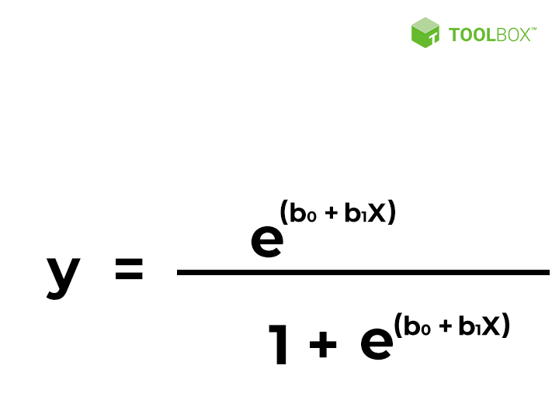
x = input value
y = predicted output
b0 = bias or intercept term
b1 = coefficient for input (x)
This equation is similar to linear regression, where the input values are combined linearly to predict an output value
using weights or coefficient values. However, unlike linear regression, the output value modeled here is a binary value
(0 or 1) rather than a numeric value.

Slide 45
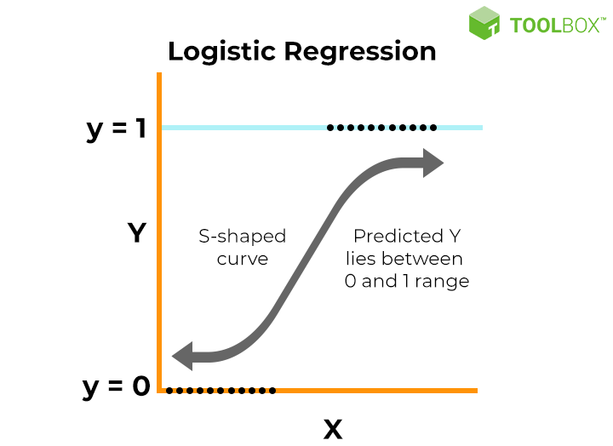

Slide 46
Key properties of the logistic regression equation
Logistic regression’s dependent variable obeys ‘Bernoulli distribution’
Estimation/prediction is based on ‘maximum likelihood.’
Logistic regression does not evaluate the coefficient of determination (or R squared) as observed in linear regression’. Instead, the model’s fitness is assessed through a concordance.

Slide 47
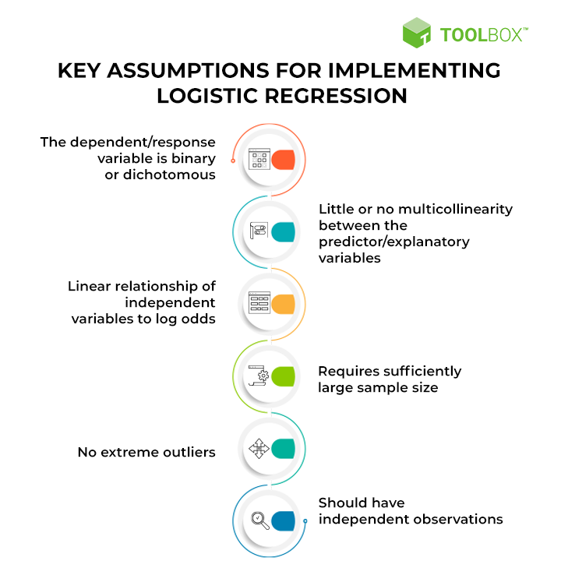

Slide 48
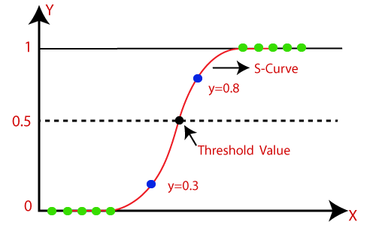
Logistic Regression can be used to classify the observations using different types of data and can easily determine the most effective variables used for the classification. The below image is showing the logistic function:

Slide 49
Logistic regression uses the concept of predictive modeling as regression; therefore, it is called logistic regression, but is used to classify samples; Therefore, it falls under the classification algorithm.
the sigmoid function is a mathematical function used to map the predicted values to probabilities.
It maps any real value into another value within a range of 0 and 1.
The value of the logistic regression must be between 0 and 1, which cannot go beyond this limit, so it forms a curve like the "S" form. The S-form curve is called the Sigmoid function or the logistic function.
In logistic regression, we use the concept of the threshold value, which defines the probability of either 0 or 1. Such as values above the threshold value tends to 1, and a value below the threshold values tends to 0.

Slide 50
Assumptions for Logistic Regression:
The dependent variable must be categorical in nature.
The independent variable should not have multi-collinearity.
Multicollinearity is a statistical concept where several independent variables in a model are correlated. Two variables are considered perfectly collinear if their correlation coefficient is +/- 1.0. Multicollinearity among independent variables will result in less reliable statistical inferences

Slide 51
Logistic Regression Equation:
The Logistic regression equation can be obtained from the Linear Regression equation. The mathematical steps to get Logistic Regression equations are given below:
We know the equation of the straight line can be written as:

Slide 52

In Logistic Regression y can be between 0 and 1 only, so for this let's divide the above equation by (1-y):

Slide 53

But we need range between -[infinity] to +[infinity], then take logarithm of the equation it will become:

Slide 54
Type of Logistic Regression:
On the basis of the categories, Logistic Regression can be classified into three types:
Binomial: In binomial Logistic regression, there can be only two possible types of the dependent variables, such as 0 or 1, Pass or Fail, etc.
Multinomial: In multinomial Logistic regression, there can be 3 or more possible unordered types of the dependent variable, such as "cat", "dogs", or "sheep"
Ordinal: In ordinal Logistic regression, there can be 3 or more possible ordered types of dependent variables, such as "low", "Medium", or "High".
Notes:
https://www.javatpoint.com/logistic-regression-in-machine-learning

Slide 55
K-Nearest Neighbor(KNN) Algorithm for Machine Learning
K-Nearest Neighbour is one of the simplest Machine Learning algorithms based on Supervised Learning technique.
K-NN algorithm assumes the similarity between the new case/data and available cases and put the new case into the category that is most similar to the available categories.
K-NN algorithm stores all the available data and classifies a new data point based on the similarity. This means when new data appears then it can be easily classified into a well suite category by using K- NN algorithm.
K-NN algorithm can be used for Regression as well as for Classification but mostly it is used for the Classification problems.
K-NN is a non-parametric algorithm, which means it does not make any assumption on underlying data.

Slide 56
It is also called a lazy learner algorithm because it does not learn from the training set immediately instead it stores the dataset and at the time of classification, it performs an action on the dataset.
KNN algorithm at the training phase just stores the dataset and when it gets new data, then it classifies that data into a category that is much similar to the new data.
Example: Suppose, we have an image of a creature that looks similar to cat and dog, but we want to know either it is a cat or dog. So for this identification, we can use the KNN algorithm, as it works on a similarity measure. Our KNN model will find the similar features of the new data set to the cats and dogs images and based on the most similar features it will put it in either cat or dog category.

Slide 57
Note that KNN isn’t the best choice for extremely large datasets. This is because the time complexity (Big O) of this algorithm is exponential.

Slide 58
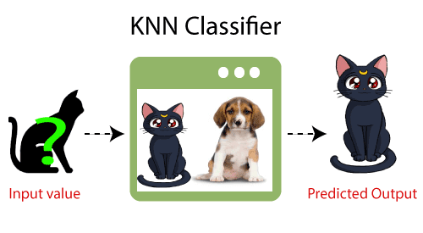

Slide 59
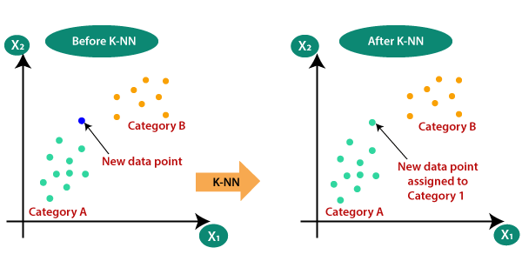
K-NN
Suppose there are two categories, i.e., Category A and Category B, and we have a new data point x1, so this data point will lie in which of these categories. To solve this type of problem, we need a K-NN algorithm. With the help of K-NN, we can easily identify the category or class of a particular dataset. Consider the below diagram:

Slide 60
How does K-NN work
Step-1: Select the number K of the neighbors
Step-2: Calculate the Euclidean distance of K number of neighbors
Step-3: Take the K nearest neighbors as per the calculated Euclidean distance.
Step-4: Among these k neighbors, count the number of the data points in each category.
Step-5: Assign the new data points to that category for which the number of the neighbor is maximum.
Step-6: Our model is ready.

Slide 61
Best K selection
There are no pre-defined statistical methods to find the best value of K in the K-nearest neighbors (KNN) algorithm. However, you can try these methods:
Square root method: Take the square root of the number of samples in the training dataset.
Cross validation method: Use cross validation to find the optimal value of K.
Error plot or accuracy plot: Use an error plot or accuracy plot to find the most favorable K value.
Mean error rate: Take a range of values of k and calculate the mean error rate of all these Ks.
A small value of K can lead to unstable decision boundaries. A large value can make it computationally expensive. Data scientists usually choose an odd number if the number of classes is 2

Slide 62
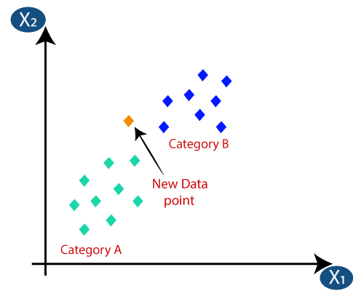
Suppose we have a new data point and we need to put it in the required category. Consider the below image:

Slide 63
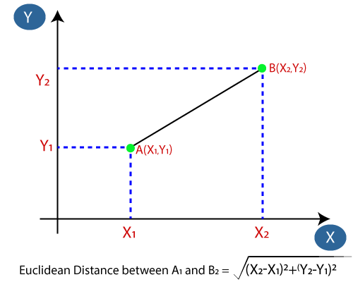
Euclidean Distance
Firstly, we will choose the number of neighbors, so we will choose the k=5.
Next, we will calculate the Euclidean distance between the data points. The Euclidean distance is the distance between two points, which we have already studied in geometry. It can be calculated as:

Slide 64
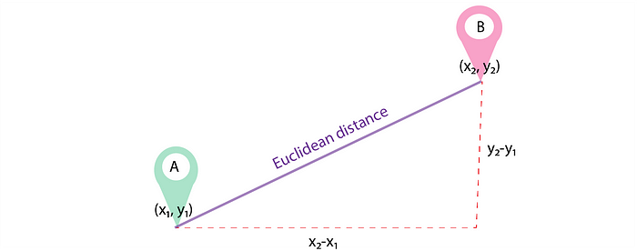
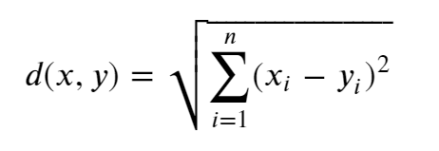
Euclidean distance
The equation at the heart of this distance is the
Pythagorean theorem!: 𝑎2+𝑏2=𝑐2.
The formula to calculate Euclidean distance is:

Slide 65
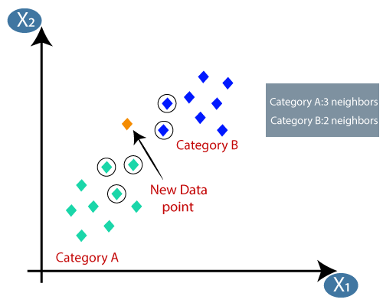
https://www.omnicalculator.com/math/euclidean-distance
By calculating the Euclidean distance we got the nearest neighbors, as three nearest neighbors in category A and two nearest neighbors in category B. Consider the below image:

Slide 66
Naive Bayes Classification
Suppose you are a product manager, you want to classify customer reviews in positive and negative classes. Or As a loan manager, you want to identify which loan applicants are safe or risky?
As a healthcare analyst, you want to predict which patients can suffer from diabetes disease. All the examples have the same kind of problem to classify reviews, loan applicants, and patients.

Slide 67
Naive Bayes is the most straightforward and fast classification algorithm, which is suitable for a large chunk of data. Naive Bayes classifier is successfully used in various applications such as spam filtering, text classification, sentiment analysis, and recommender systems. It uses Bayes theorem of probability for prediction of unknown class

Slide 68
What is Naive Bayes Classifier?
Naive Bayes is a statistical classification technique based on Bayes Theorem. It is one of the simplest supervised learning algorithms. Naive Bayes classifier is the fast, accurate and reliable algorithm. Naive Bayes classifiers have high accuracy and speed on large datasets.
Naive Bayes classifier assumes that the effect of a particular feature in a class is independent of other features. For example, a loan applicant is desirable or not depending on his/her income, previous loan and transaction history, age, and location. Even if these features are interdependent, these features are still considered independently. This assumption simplifies computation, and that's why it is considered as naive. This assumption is called class conditional independence.

Slide 69

P(h): the probability of hypothesis h being true (regardless of the data). This is known as the prior probability of h.
P(D): the probability of the data (regardless of the hypothesis). This is known as the prior probability.
P(h|D): the probability of hypothesis h given the data D. This is known as posterior probability.
P(D|h): the probability of data d given that the hypothesis h was true. This is known as posterior probability.

Slide 70
How Naive Bayes Classifier Works?
Let’s understand the working of Naive Bayes through an example. Given an example of weather conditions and playing sports. You need to calculate the probability of playing sports. Now, you need to classify whether players will play or not, based on the weather condition.
Step 1: Calculate the prior probability for given class labels
Step 2: Find Likelihood probability with each attribute for each class
Step 3: Put these value in Bayes Formula and calculate posterior probability.
Step 4: See which class has a higher probability, given the input belongs to the higher probability class.

Slide 71
prior and posterior probability calculation
For simplifying prior and posterior probability calculation,
you can use the two tables frequency and likelihood tables.
Both of these tables will help you to calculate the prior and posterior probability.
The Frequency table contains the occurrence of labels for all features.
There are two likelihood tables.
Likelihood Table 1 is showing prior probabilities of labels
&
Likelihood Table 2 is showing the posterior probability.

Slide 72
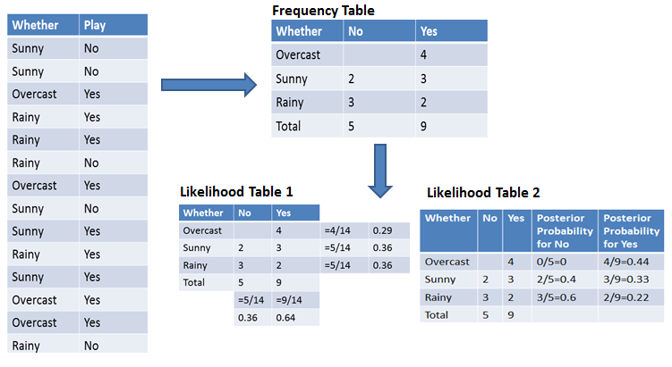

Slide 73
Now suppose you want to calculate the probability of playing when the weather is overcast.
Probability of playing:
P(Yes | Overcast) = P(Overcast | Yes) P(Yes) / P (Overcast) .....................(1)
Calculate Prior Probabilities:
P(Overcast) = 4/14 = 0.29
P(Yes)= 9/14 = 0.64
Calculate Posterior Probabilities:
P(Overcast |Yes) = 4/9 = 0.44
Put Prior and Posterior probabilities in equation (1)
P (Yes | Overcast) = 0.44 * 0.64 / 0.29 = 0.98(Higher)
Similarly, you can calculate the probability of not playing:

Slide 74
Probability of not playing:
P(No | Overcast) = P(Overcast | No) P(No) / P (Overcast) .....................(2)
Calculate Prior Probabilities:
P(Overcast) = 4/14 = 0.29
P(No)= 5/14 = 0.36
Calculate Posterior Probabilities:
P(Overcast |No) = 0/9 = 0
Put Prior and Posterior probabilities in equation (2)
P (No | Overcast) = 0 * 0.36 / 0.29 = 0
The probability of a 'Yes' class is higher. So you can determine here if the weather is overcast than players will play the sport.

Slide 75
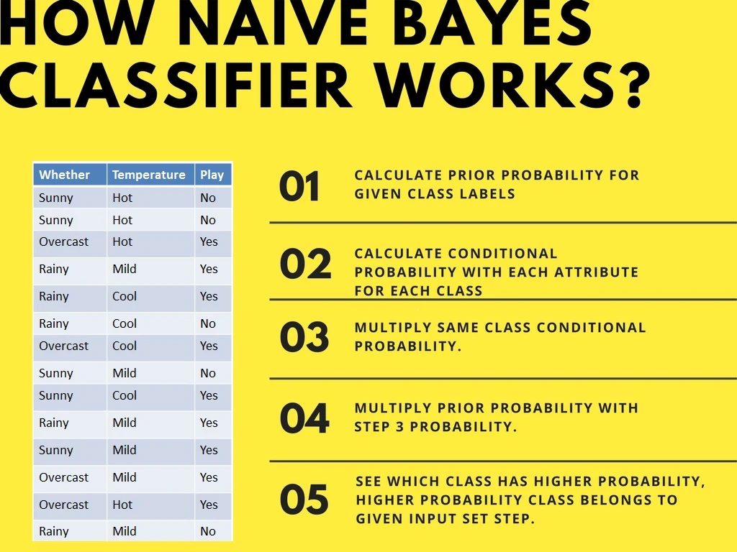
Second Approach (In case of multiple features)

Slide 76
Now suppose you want to calculate the probability of playing when the weather is overcast, and the temperature is mild.
Probability of playing:
P(Play= Yes | Weather=Overcast, Temp=Mild) = P(Weather=Overcast, Temp=Mild | Play= Yes)P(Play=Yes) ..........(1)
P(Weather=Overcast, Temp=Mild | Play= Yes)= P(Overcast |Yes) P(Mild |Yes) ………..(2)
Calculate Prior Probabilities: P(Yes)= 9/14 = 0.64
Calculate Posterior Probabilities: P(Overcast |Yes) = 4/9 = 0.44 P(Mild |Yes) = 4/9 = 0.44
Put Posterior probabilities in equation (2) P(Weather=Overcast, Temp=Mild | Play= Yes) = 0.44 * 0.44 = 0.1936(Higher)
Put Prior and Posterior probabilities in equation (1) P(Play= Yes | Weather=Overcast, Temp=Mild) = 0.1936*0.64 = 0.124
Notes:
https://www.datacamp.com/tutorial/naive-bayes-scikit-learn

Slide 77
Probability of not playing:
P(Play= No | Weather=Overcast, Temp=Mild) = P(Weather=Overcast, Temp=Mild | Play= No)P(Play=No) ..........(3)
P(Weather=Overcast, Temp=Mild | Play= No)= P(Weather=Overcast |Play=No) P(Temp=Mild | Play=No) ………..(4)
Calculate Prior Probabilities: P(No)= 5/14 = 0.36
Calculate Posterior Probabilities: P(Weather=Overcast |Play=No) = 0/9 = 0 P(Temp=Mild | Play=No)=2/5=0.4
Put posterior probabilities in equation
(4) P(Weather=Overcast, Temp=Mild | Play= No) = 0 * 0.4= 0
Put prior and posterior probabilities in equation
(3) P(Play= No | Weather=Overcast, Temp=Mild) = 0*0.36=0
The probability of a 'Yes' class is higher. So you can say here that if the weather is overcast than players will play the sport.

Slide 78
Support Vector Machine Algorithm
Support Vector Machine or SVM is one of the most popular Supervised Learning algorithms, which is used for Classification as well as Regression problems. However, primarily, it is used for Classification problems in Machine Learning.
The goal of the SVM algorithm is to create the best line or decision boundary that can segregate n-dimensional space into classes so that we can easily put the new data point in the correct category in the future. This best decision boundary is called a hyperplane.

Slide 79

hyperplane
SVM chooses the extreme points/vectors that help in creating the hyperplane. These extreme cases are called as support vectors, and hence algorithm is termed as Support Vector Machine. Consider the below diagram in which there are two different categories that are classified using a decision boundary or hyperplane:

Slide 80
Example.
SVM can be understood with the example that we have used in the KNN classifier. Suppose we see a strange cat that also has some features of dogs, so if we want a model that can accurately identify whether it is a cat or dog, so such a model can be created by using the SVM algorithm. We will first train our model with lots of images of cats and dogs so that it can learn about different features of cats and dogs, and then we test it with this strange creature.
So as support vector creates a decision boundary between these two data (cat and dog) and choose extreme cases (support vectors), it will see the extreme case of cat and dog. On the basis of the support vectors, it will classify it as a cat. Consider the below diagram:

Slide 81
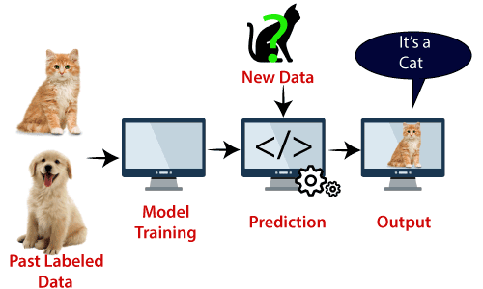
SVM algorithm can be used for Face detection, image classification, text categorization, etc.

Slide 82
Types of SVM
Linear SVM: Linear SVM is used for linearly separable data, which means if a dataset can be classified into two classes by using a single straight line, then such data is termed as linearly separable data, and classifier is used called as Linear SVM classifier.
Non-linear SVM: Non-Linear SVM is used for non-linearly separated data, which means if a dataset cannot be classified by using a straight line, then such data is termed as non-linear data and classifier used is called as Non-linear SVM classifier.

Slide 83
Hyperplane and Support Vectors in the SVM algorithm:
Hyperplane: There can be multiple lines/decision boundaries to segregate the classes in n-dimensional space, but we need to find out the best decision boundary that helps to classify the data points. This best boundary is known as the hyperplane of SVM.
The dimensions of the hyperplane depend on the features present in the dataset, which means if there are 2 features (as shown in image), then hyperplane will be a straight line. And if there are 3 features, then hyperplane will be a 2-dimension plane.
We always create a hyperplane that has a maximum margin, which means the maximum distance between the data points.

Slide 84
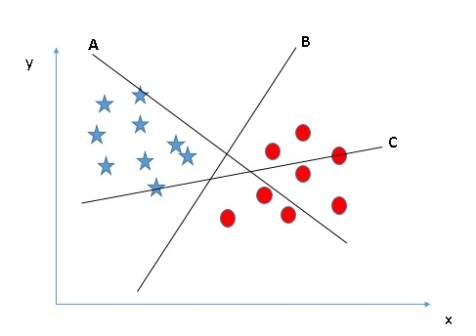
How Does a Support Vector Machine / SVM Work?
Identify the right hyper-plane (Scenario-1): Here, we have three hyper-planes (A, B, and C). Now, identify the right hyper-plane to classify stars and circles.
You need to remember a thumb rule to
identify the right hyper-plane: “Select the
hyper-plane which segregates the two
classes better.” In this scenario, hyper-plane
“B” has excellently performed this job.

Slide 85
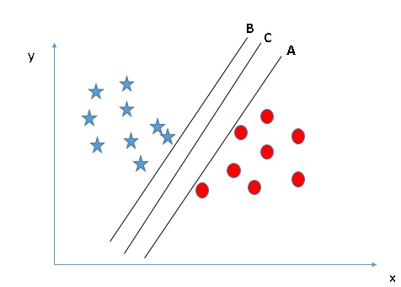
Identify the right hyper-plane (Scenario-2): Here, we have three hyper-planes (A, B, and C), and all segregate the classes well. Now, How can we identify the right hyper-plane?

Slide 86
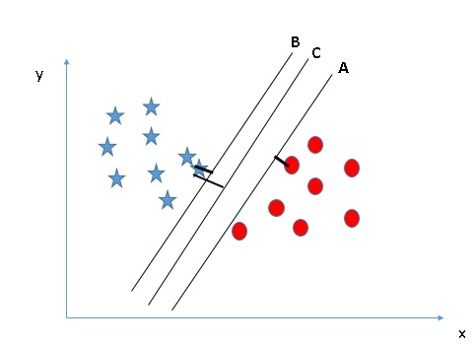
Here, maximizing the distances between the nearest data point (either class) and the hyper-plane will help us to decide the right hyper-plane. This distance is called a Margin. Let’s look at the below snapshot:
Above, you can see that the margin for hyper-plane C is high as compared to both A and B. Hence, we name the right
hyper-plane as C. Another lightning reason for selecting the hyper-plane with a higher margin is robustness. If we
select a hyper-plane having a low margin, then there is a high chance of misclassification.

Slide 87
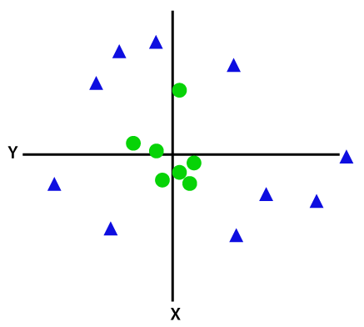
Non-Linear SVM:
If data is linearly arranged, then we can separate it by using a straight line, but for non-linear data, we cannot draw a single straight line. Consider the below image.

Slide 88
So to separate these data points, we need to add one more dimension. For linear data, we have used two dimensions x and y, so for non-linear data, we will add a third dimension z. It can be calculated as:
z=x2 +y2
By adding the third dimension, the sample space will become as below image:

Slide 89

Popular kernel functions in SVM
The SVM kernel is a function that takes low-dimensional input space and transforms it into higher-dimensional space, ie it converts nonseparable problems to separable problems. It is mostly useful in non-linear separation problems. Simply put the kernel, does some extremely complex data transformations and then finds out the process to separate the data based on the labels or outputs defined.

Slide 90
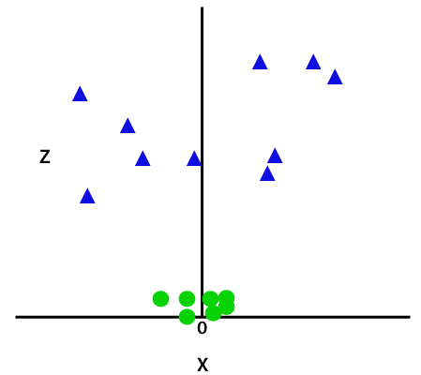
So now, SVM will divide the datasets into classes in the following way. Consider the below image:

Slide 91
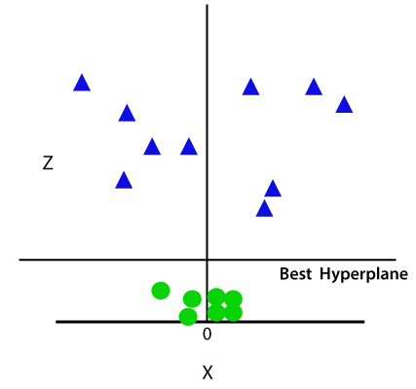

Slide 92
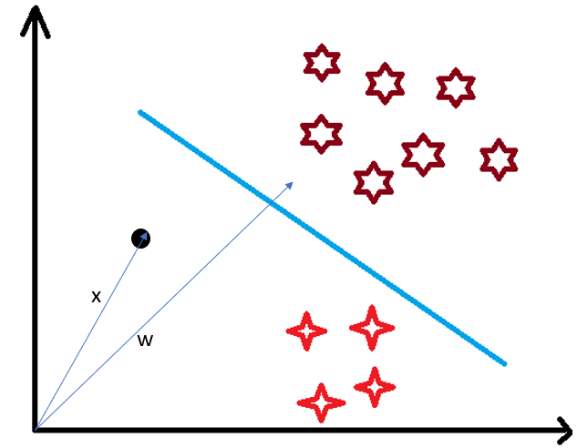
Use of Dot Product in SVM
Consider a random point X and we want to know whether it lies on the right side of the plane or the left side of the plane
(positive or negative).
To find this first we assume this point is a vector (X) and then we
make a vector (w) which is perpendicular to the hyperplane.
Let’s say the distance of vector w from origin to decision boundary
is ‘c’.
Now we take the projection of X vector on w.

Slide 93
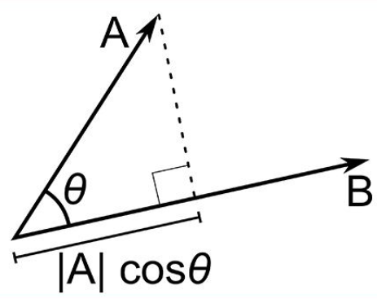
Understanding Dot-Product
We all know that a vector is a quantity that has magnitude as well as direction and just like numbers we can use mathematical operations such as addition, multiplication.
Multiplication of vectors which can be done in two ways, dot product, and cross product.
The difference is only that the dot product is used to get a scalar value as a resultant whereas cross-product is used to obtain a vector again.
The dot product can be defined as the projection of one vector along with another, multiply by the product of another vector.

Slide 94
Here a and b are 2 vectors, to find the dot product between these 2 vectors we first find the magnitude of both the vectors and to find magnitude we use the Pythagorean theorem or the distance formula.
After finding the magnitude we simply multiply it with the cosine angle between both the vectors. Mathematically it can be written as:
A . B = |A| cosθ * |B|
Where |A| cosθ is the projection of A on B
And |B| is the magnitude of vector B
Now in SVM we just need the projection of A not the magnitude of B
To just get the projection we can simply take the unit vector of B because it will be in the direction of B but its magnitude will be 1. Hence now the equation becomes:
A.B = |A| cosθ * unit vector of B

Slide 95
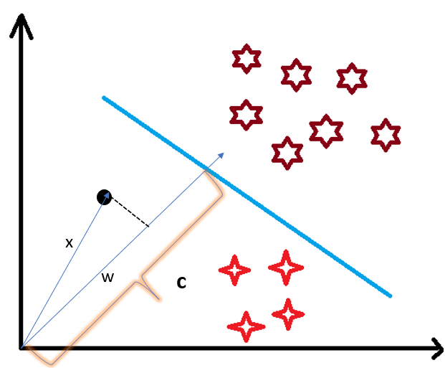
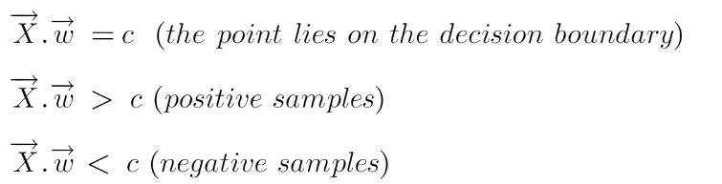
projection of any vector or another vector
is called dot-product.
Hence, we take the dot product of x and w
vectors. If the dot product is greater than ‘c’ then
we can say that the point lies on the right side.
If the dot product is less than ‘c’ then the point is on
the left side and if the dot product is equal to ‘c’
then the point lies on the decision boundary.

Slide 96
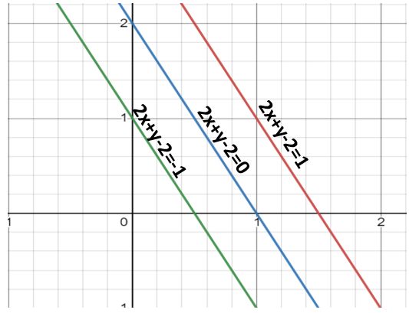
Calculate margin from w.x+b=0
over here 2x+y-2=0

Slide 97
Support Vector Machine Terminology
Hyperplane: Hyperplane is the decision boundary that is used to separate the data points of different classes in a feature space. In the case of linear classifications, it will be a linear equation i.e. wx+b = 0.
Support Vectors: Support vectors are the closest data points to the hyperplane, which makes a critical role in deciding the hyperplane and margin.
Margin: Margin is the distance between the support vector and hyperplane. The main objective of the support vector machine algorithm is to maximize the margin. The wider margin indicates better classification performance.
Kernel: Kernel is the mathematical function, which is used in SVM to map the original input data points into high-dimensional feature spaces, so, that the hyperplane can be easily found out even if the data points are not linearly separable in the original input space. Some of the common kernel functions are linear, polynomial, radial basis function(RBF), and sigmoid.
Hard Margin: The maximum-margin hyperplane or the hard margin hyperplane is a hyperplane that properly separates the data points of different categories without any misclassifications.

Slide 98
Soft Margin: When the data is not perfectly separable or contains outliers, SVM permits a soft margin technique. Each data point has a slack variable introduced by the soft-margin SVM formulation, which softens the strict margin requirement and permits certain misclassifications or violations. It discovers a compromise between increasing the margin and reducing violations.
C: Margin maximisation and misclassification fines are balanced by the regularisation parameter C in SVM. The penalty for going over the margin or misclassifying data items is decided by it. A stricter penalty is imposed with a greater value of C, which results in a smaller margin and perhaps fewer misclassifications.
Hinge Loss: A typical loss function in SVMs is hinge loss. It punishes incorrect classifications or margin violations. The objective function in SVM is frequently formed by combining it with the regularisation term.
Dual Problem: A dual Problem of the optimisation problem that requires locating the Lagrange multipliers related to the support vectors can be used to solve SVM. The dual formulation enables the use of kernel tricks and more effective computing.

Slide 99
Advantages of SVM
Effective in high-dimensional cases.
Its memory is efficient as it uses a subset of training points in the decision function called support vectors.
Different kernel functions can be specified for the decision functions and its possible to specify custom kernels

